Slide 1
Fundamentals of Electric Grid Transmission Planning
Talk 1: Overview of the Electric Grid and History of Electric Grid Planning
Prof. Tom Overbye
Dept. of Electrical and Computer Engineering
Texas A&M University
overbye@tamu.edu

Slide 2

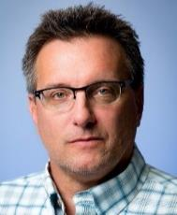

Welcome and Introduction
The goal of this course is to provide a comprehensive introduction for those without an in-depth electric power engineering background on how such electric grids are designed and operated, and on how they are likely to change in the future.
The focus is mostly on the practical application of concepts with a number of hands-on activities
Course has three instructors with (combined) many years of grid experience
Tom Overbye (Course Director) Tracy Rolstad
Scott Dahman

Slide 3



Venue Logistics
Course will be from 8:15 am to 5 pm each day except finishing by 4:30 pm on the last day
A light breakfast and lunch is provided along with snacks and Tuesday dinner
Parking is included with registration, but you need to register the car’s license at front desk each day
Andrea Kishné, Jonathan Snodgrass and Eric Keller are handling course administration and technical issues
Questions are encouraged throughout!!
We’ve included lots of hands-on exercises to help explain the course concepts
Slides, Example PowerWorld cases and videos are on the usbs
2

Slide 4
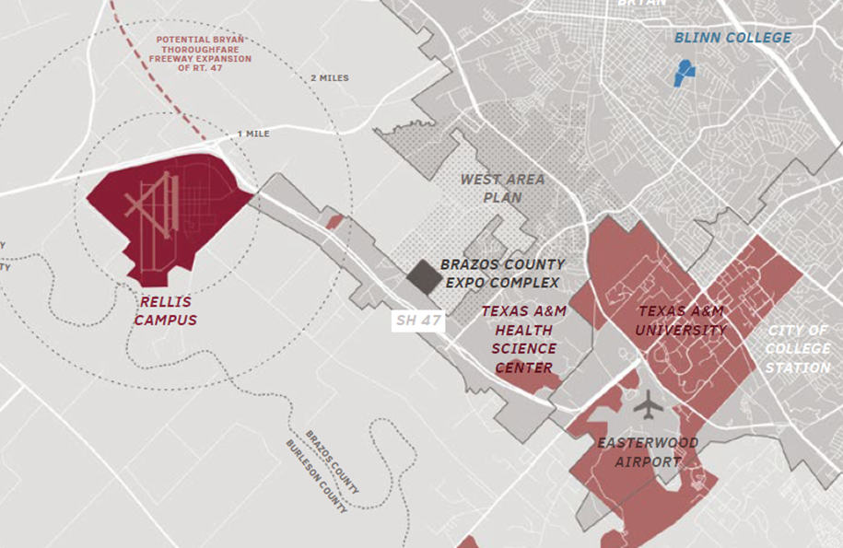
Venue: Center for Infrastructure Renewal (CIR)
We are located at the CIR on the Texas A&M RELLIS Campus
RELLIS is part of the Texas A&M System, and is named for our core values of Respect, Excellence, Loyalty, Leadership, Integrity, Selfless Service
This is the former Bryan Army Air Field used in WWII for pilot training, acquired by A&M in 1982 as the Riverside Campus; renamed RELLIS in 2016
3

Slide 5
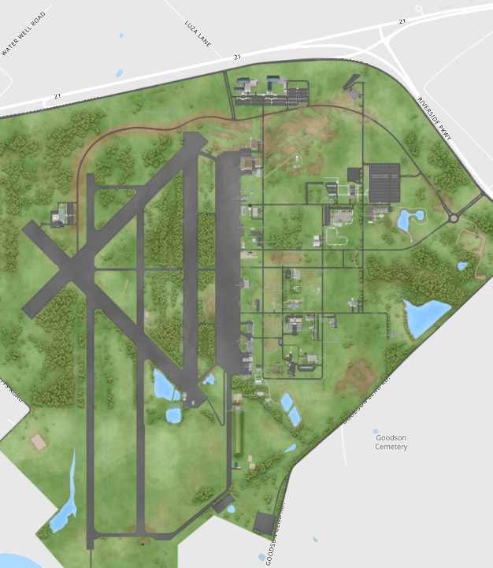
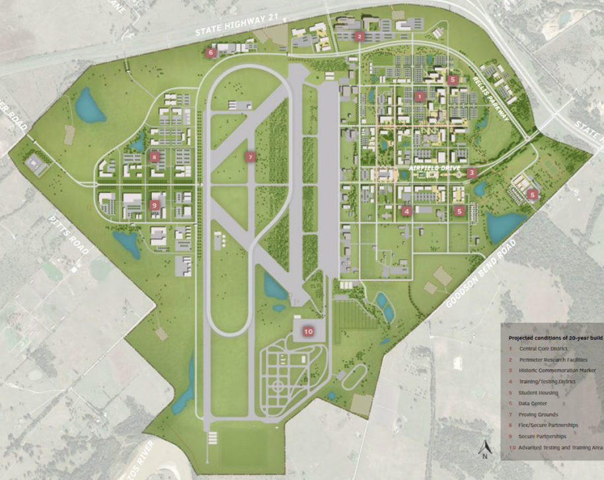
RELLIS Master Plan
If you are interested in learning more about RELLIS, go to rellis.tamus.edu
We are here in the CIR
Master Plan
4

Slide 6
About Me: Professional
Received BSEE, MSEE, and Ph.D. from UW-Madison
Worked for eight years as engineer for Madison Gas & Electric
Was at UIUC from 1991 to 2016, doing teaching and doing research in the area of electric power systems
Joined TAMU in January 2017; Taught many power systems classes over last 29 years
Developed commercial power system analysis package, known now as PowerWorld Simulator. This package has been sold to about 1000 different corporate entities worldwide
DOE investigator for 8/14/2003 blackout
Member US National Academy of Engineering; now Section 6 Vice Chair
5

Slide 7
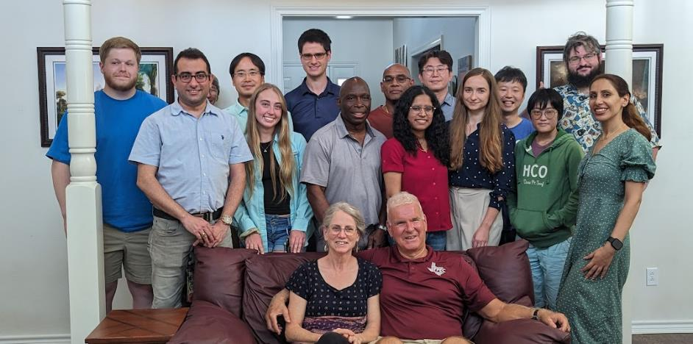




About Me: TAMU Research Group
6

Slide 8
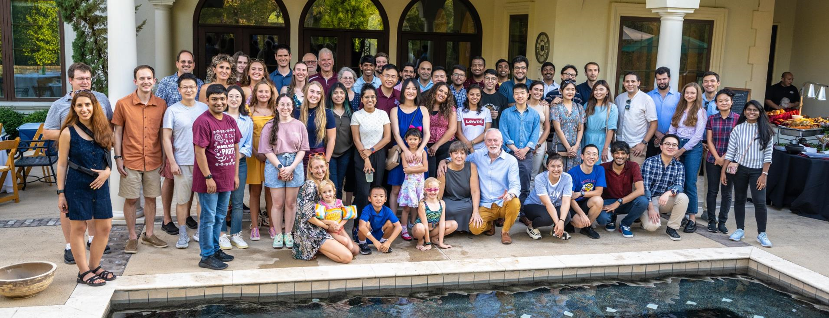
TAMU Energy and Power Group Fall 2023 Dinner
Held at Miroslav’s house in September; you’ll see some of these people around
7

Slide 9


About Me: Nonprofessional
Married to Jo; and have three children: Tim, Hannah (now with Will) and Amanda
We homeschooled our kids with Tim now a PhD student at TAMU, Hannah is doing a PhD at UCSB in communications (and recently got married) and Amanda graduated from Belmont in environmental sciences
Jo is a counselor (LPC), we attend Grace Bible Church in College Station and teach 4th graders class (Creekside)
I am the faculty advisor for Christian Engineering Leaders; I also like swimming, watching football (Aggies and Packers!)
8

Slide 10
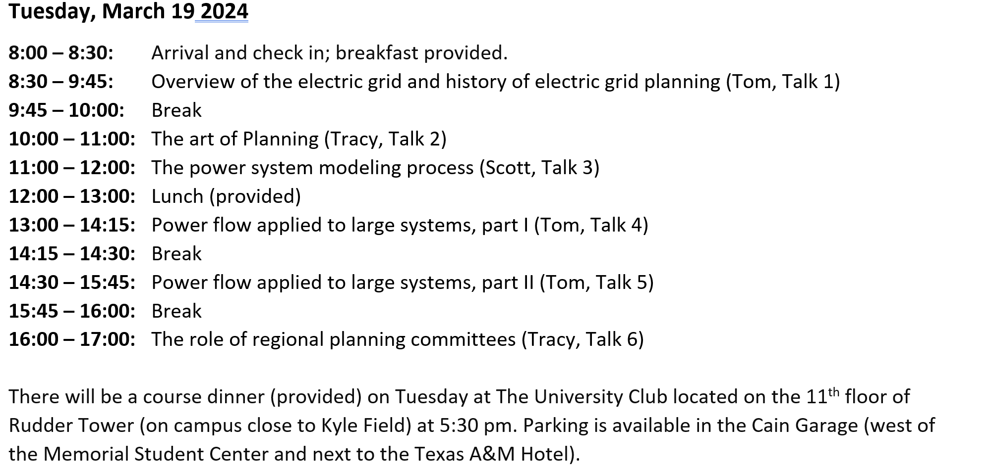
Short Course Topics, Tuesday
9

Slide 11
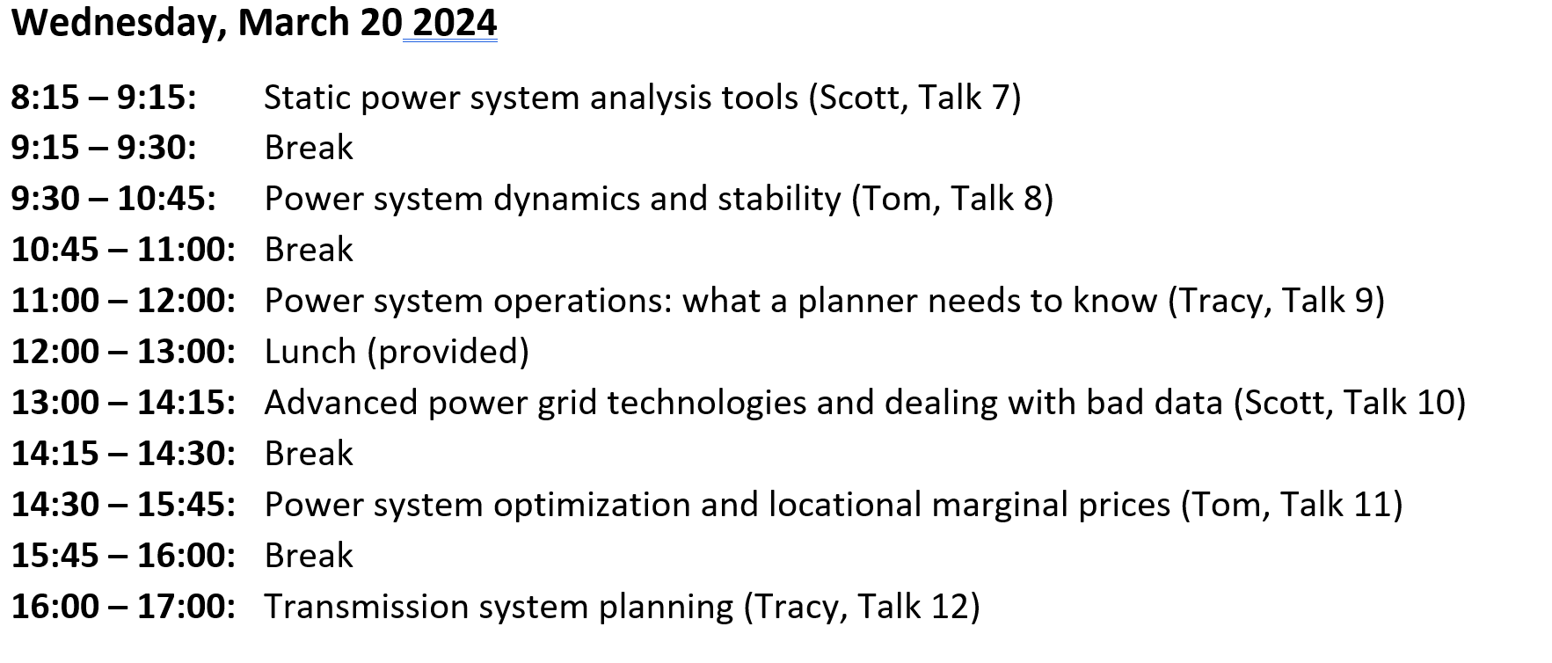
Short Course Topics, Wednesday
10

Slide 12
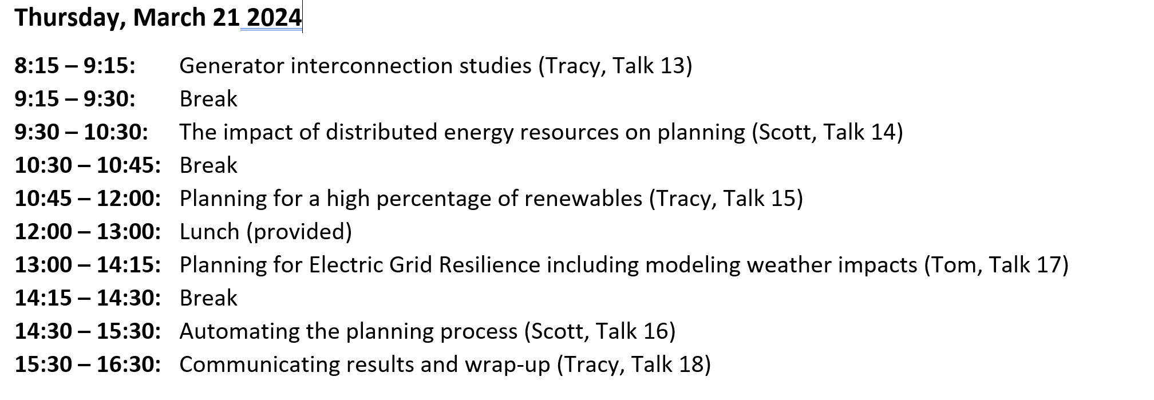
Short Course Topics, Thursday
11

Slide 13
Electric Grid Overview
Generation – source of electric energy
Coal had provided over half of the U.S. electric energy, but now natural gas leads, with renewable sources rapidly growing
Load – consumes electric energy
Consumers are in complete control of the switch; utilities must supply enough power to meet load
Transmission and Distribution – the wires that carry the power from generation to load
Operating at voltages up to 765 kV (kilovolt), with 500 kV, 345 kV, 230 kV 161 kV and 138 kV common
Image source is US DOE, www.energy.gov/indianenergy/articles/united-states-electricity-industry-primer
12

Slide 14
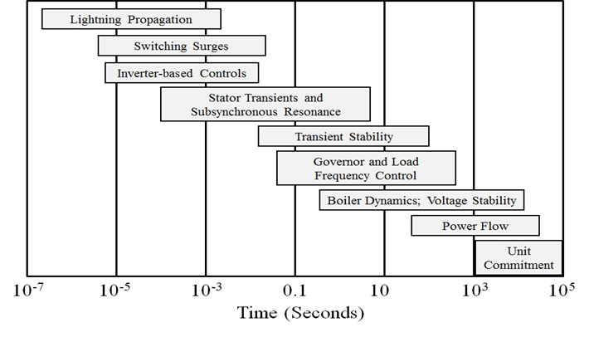
Electric Grid Time Frames
Image: Sauer, P.W., M. A. Pai, Power System Dynamics and Stability, Stripes Publishing, 2007
13

Slide 15
Power and Energy
Power is the instantaneous transfer of energy; expressed in watts (W), kW, MW, GW
US installed generation capacity is about 1000 GW
Energy is the integration of power over time; expressed in units of joules (J = 1 W-sec), kWh (3.6 x 10⁶ J), or btu (1055 J; 1 MBtu=0.292 MWh)
U.S. electric energy consumption is about 4150 billion kWh (about 12,500 kWh per person; 1.4 kW continuous per person on average)
14

Slide 16
AC System Analysis
The power grid is an ac system, operating at close to 60 Hz in North America, 50 Hz in many other places
Constant frequency ac systems are analyzed using phasor analysis, which expresses a time varying value, such as a voltage or current, as a magnitude and phase angle
v(t) = V_{max} cos(ωt + θ_{v}) → V_{rms}∠ θ_{v}
Phase angle is always with respect to an arbitrary reference angle
Here we’ll almost always be talking about ac systems and looking at the average power over a cycle
This is one of the few equations in my slides!
15

Slide 17
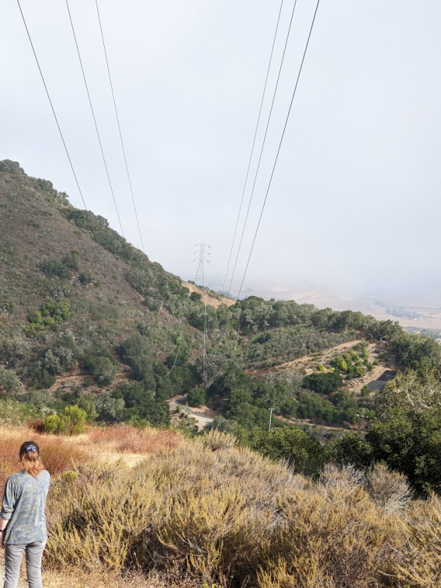
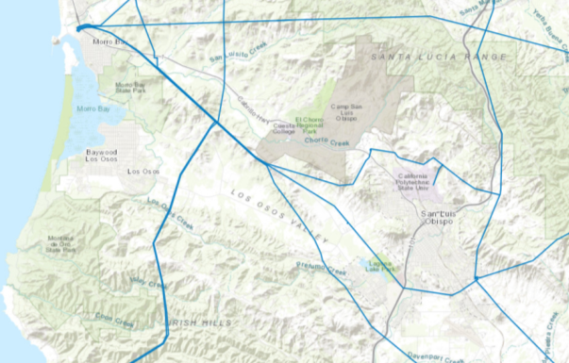
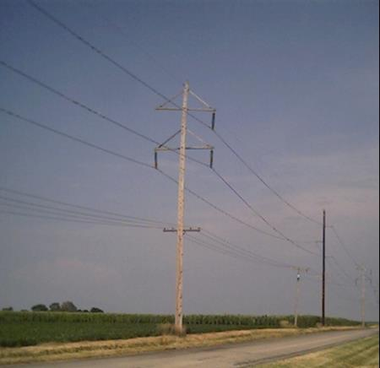
Three-Phase Systems
Essentially all large-scale electric grids are three-phase
Three wires, with the same voltage magnitude and a phase shift of 120 degrees
Usually the high voltage electric grid is “balanced,”
This means that it can be very well modeled as an equivalent single-phase system
The three-phase lines are often shown with a single line, what is known as a oneline
230 kV dual circuit
138 kV
16

Slide 18
Interconnected Power System Basic Characteristics
Three – phase AC systems:
generation and transmission equipment is usually three phase
industrial loads are three phase
residential and commercial loads are single phase and distributed equally among the phases; consequently, a balanced three – phase system results
Synchronous machines have traditionally generated electricity, though this is rapidly changing with the addition of more inverter-connected generation (such as solar and most wind)
Interconnection transmits power over a wider region with subsystems operating at different voltage levels
17

Slide 19
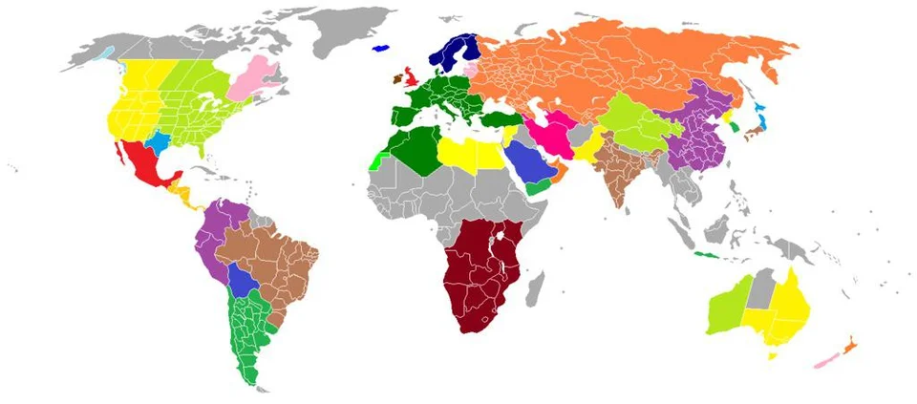
Synchronous Electric Grids
Much of the electricity in the developed world is supplied by large-scale, 60 or 50 Hz synchronous electric grids
Such grids can provide improved reliability, larger electricity markets and often economics of scale
However, they add planning complexities
Power can be transferred between synchronous grids by first converting it to dc, with HVDC lines one example
Islands, and other parts of the world are supplied by smaller electric grids
Large-Scale Electric Grid Interconnections
Image Source: i.redd.it/krkhdfslrjh61.jpg
18

Slide 20
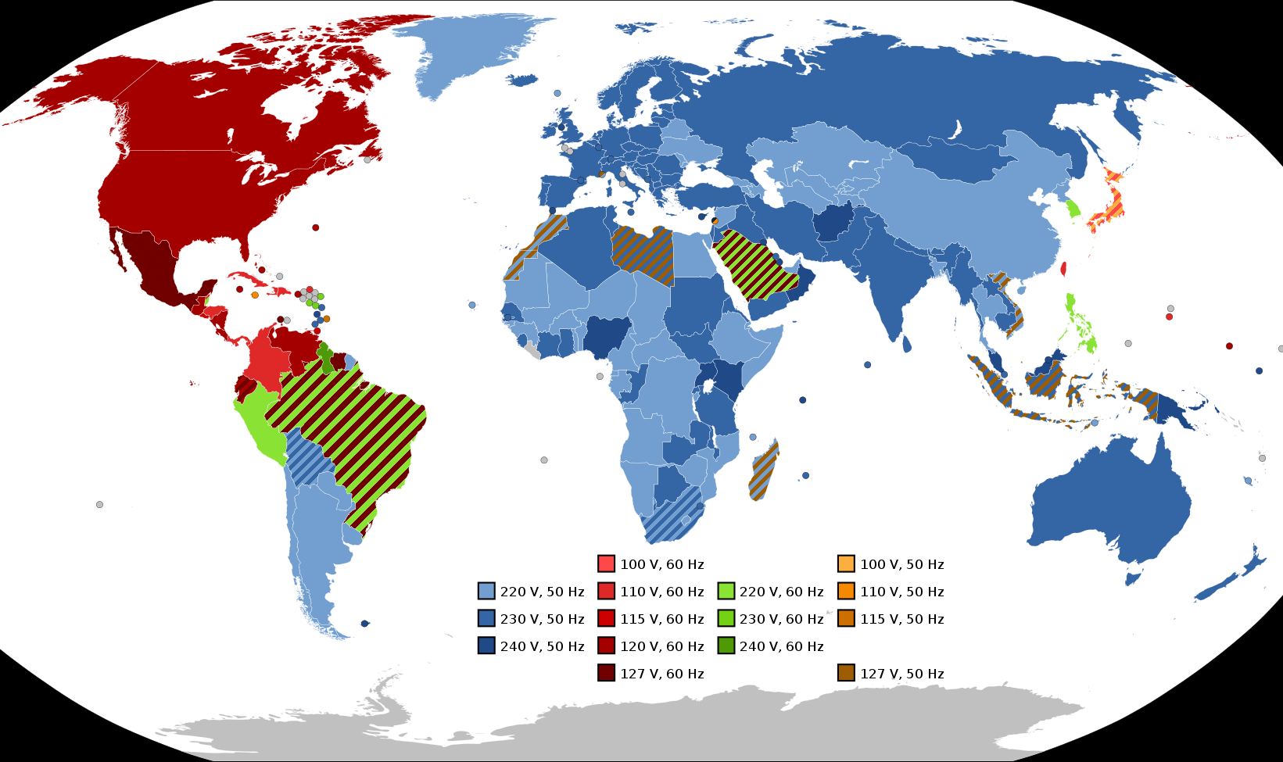
Electric Frequencies and Residential Voltages Worldwide
In the US the supplied residential voltage should be 120 V, with a 5% range allowed
Image Source: en.wikipedia.org/wiki/Mains_electricity_by_country#/media/File:World_Map_of_Mains_Voltages_and_Frequencies,_Detailed.svg
19

Slide 21
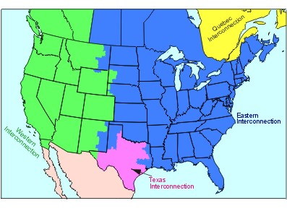
North America Interconnections
20

Slide 22
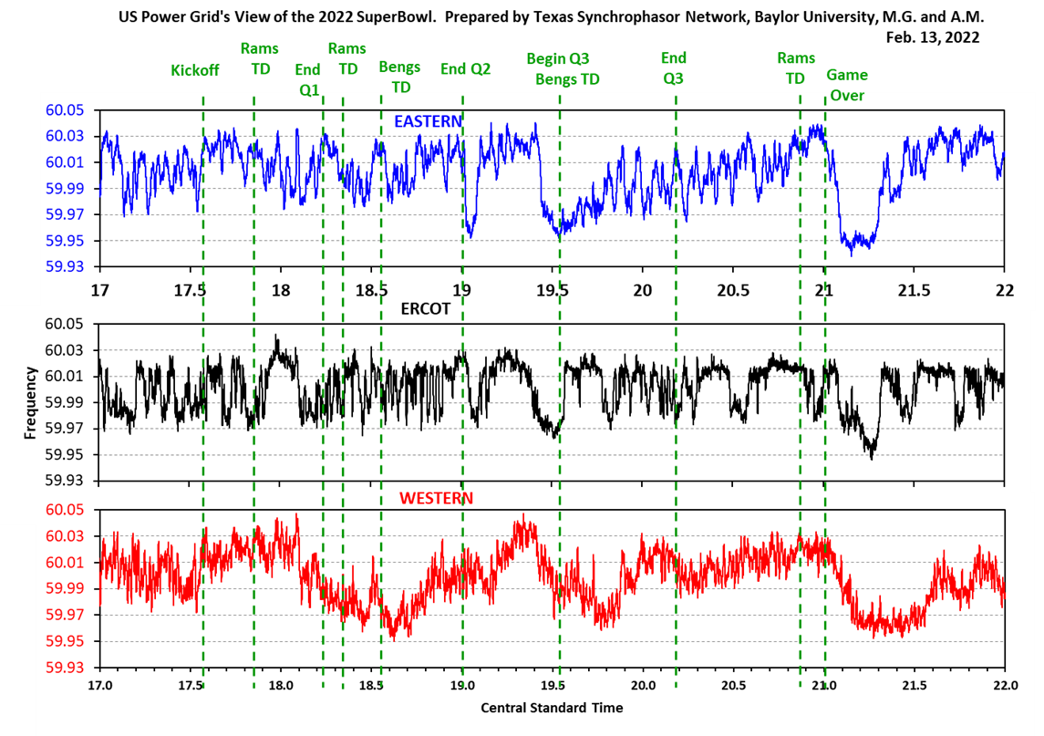
All Three US Grids Are 60 Hz, But Are Not Usually At the Same Value
Images show the frequency during the 2022 Super Bowl (2/13/22)
Image from Prof. Mack Grady of Baylor University
21

Slide 23
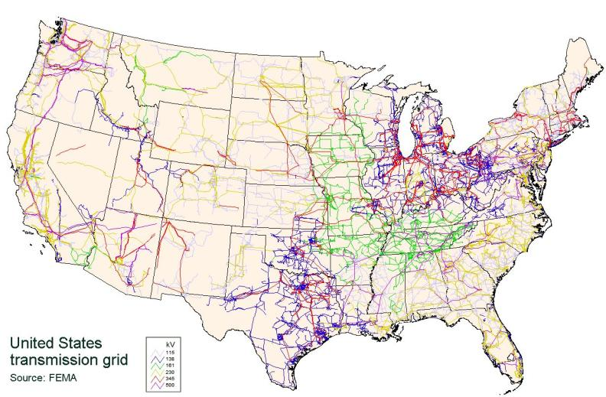
Continental US Transmission Grid
The Continental US Grid is interconnected with Canada and parts of Mexico
22

Slide 24
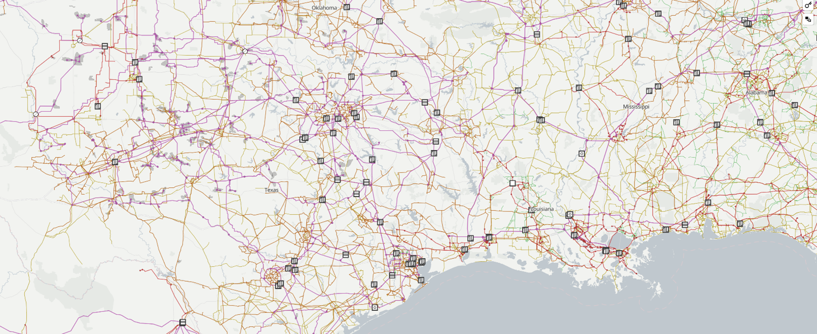
A Nice Visualization of Worldwide Electric Grids
The website openinframap.org visualizes the worldwide electric grid information contained in the OpenStreetMap database
23

Slide 25
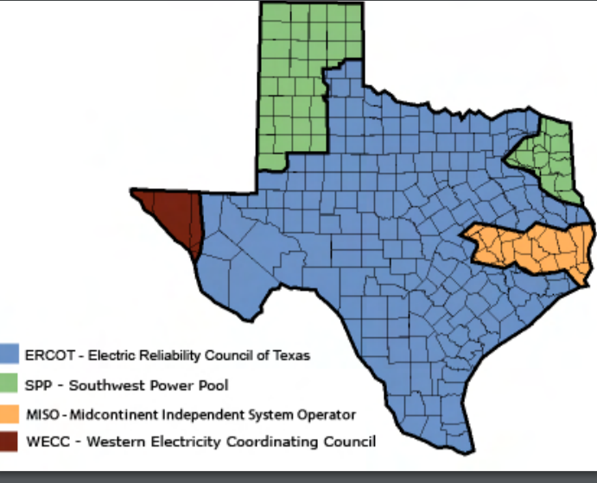
Electric Interconnections in Texas
El Paso is in the Western Interconnect (WECC) and parts of North and East Texas are in the Eastern Interconnect (EI) (with the boundaries in the image just approximate)
Lubbock Power and Light customers joined ERCOT in May 2021
Source: www.puc.texas.gov/industry/maps/maps/ERCOT.pdf
24

Slide 26
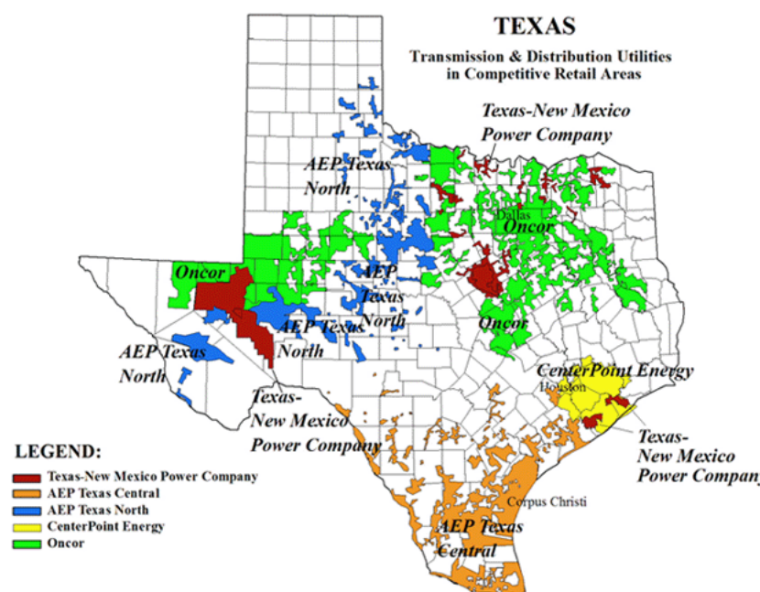
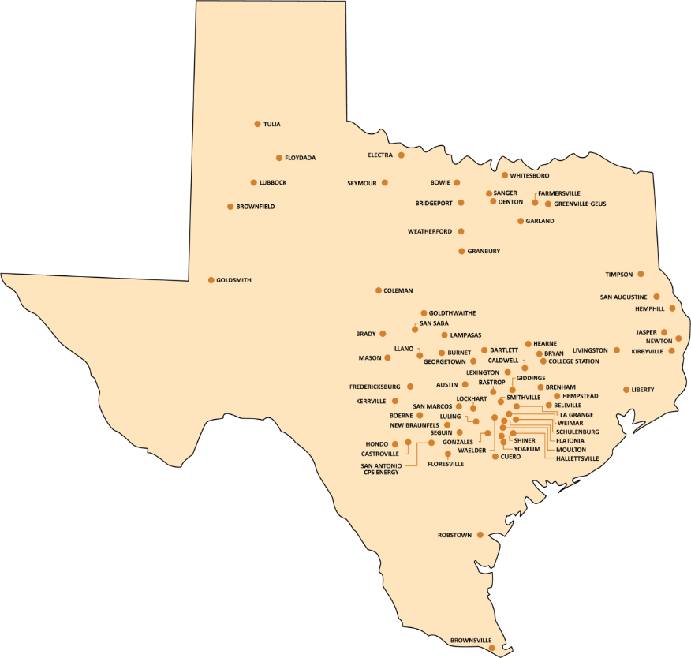
Electric Utilities in Texas (IOUs and Municipals)
25

Slide 27
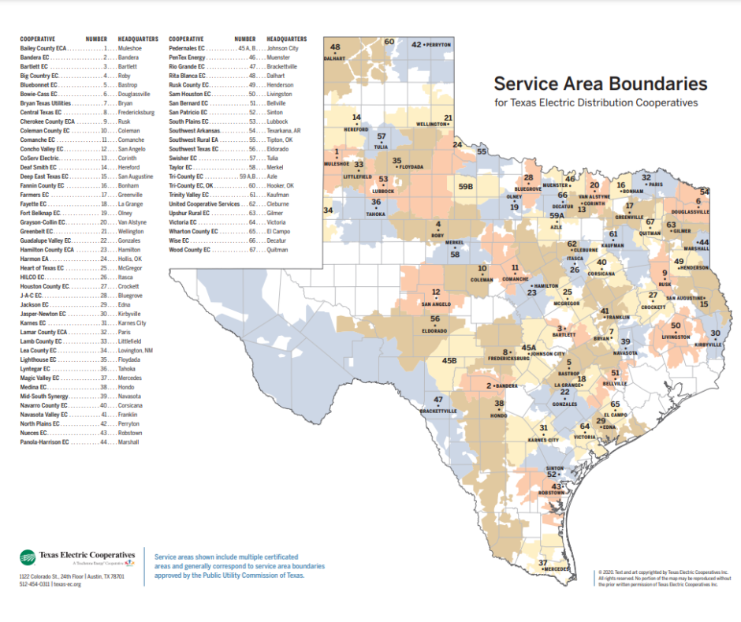
Electric Utilities in Texas (Coops)
26

Slide 28
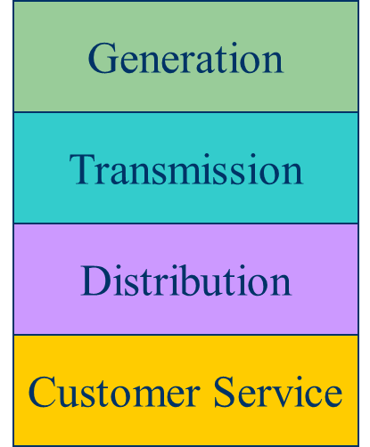
Historical Electric Utility Organization
Traditionally electric utilities were vertical monopolies; within a particular geographic market, they had an exclusive franchise
This has changed in many places around the country
In return for this exclusive franchise, the utility had the obligation to serve all
existing and future customers at rates determined jointly by utility and regulators.
27

Slide 29
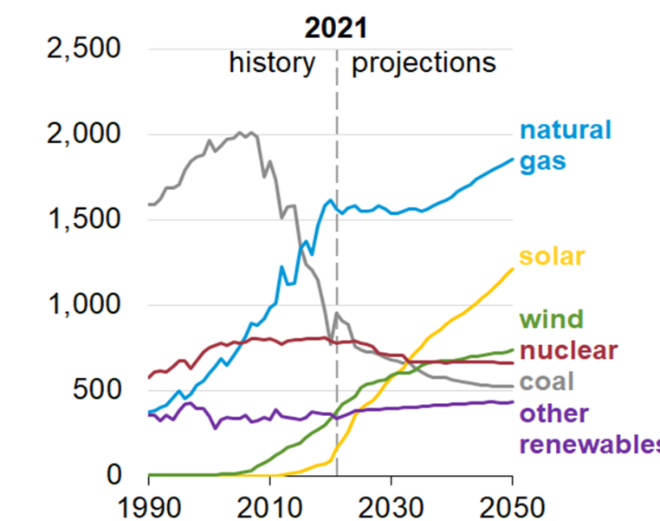
Generation
Natural Gas (38.4%) and coal (21.3%) are most common sources, followed by nuclear (18.6%), wind (9.7), hydro (6.4%), solar (4.2%)
Wood is 0.9%, geothermal 0.4%
Coal was at least 50% of the total up to 2007
New construction mostly wind, solar and natural gas (with wind and solar energy costs now quite low)
US Generator Capacity Additions
Sources are by energy (not capacity), source US EIA
28

Slide 30
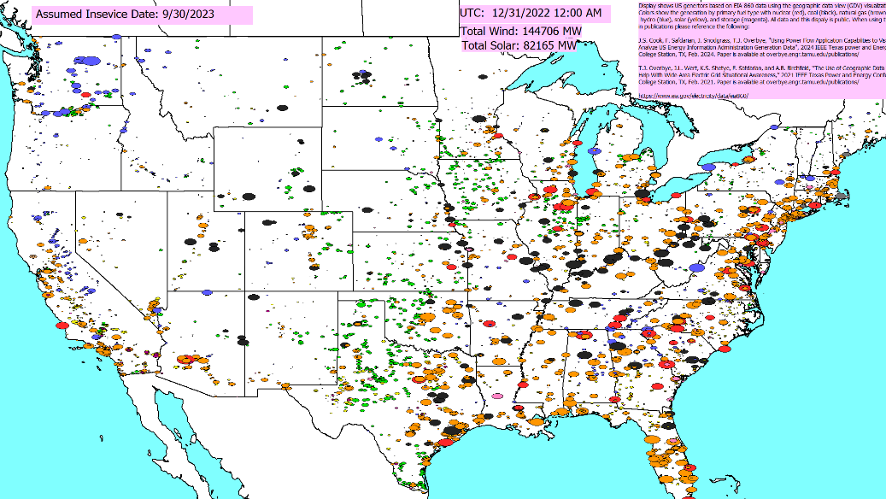
US Generation (September 2023) by Fuel Type
Image Source: www.eia.gov/electricity/data/eia860m/
29

Slide 31
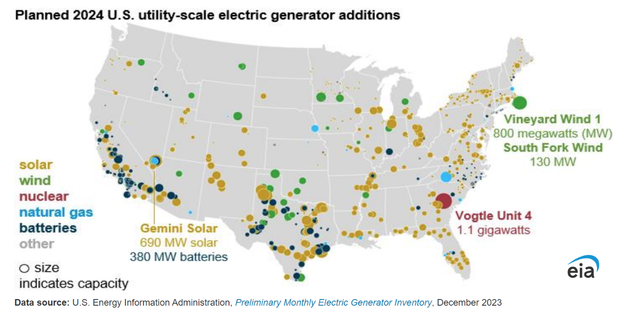
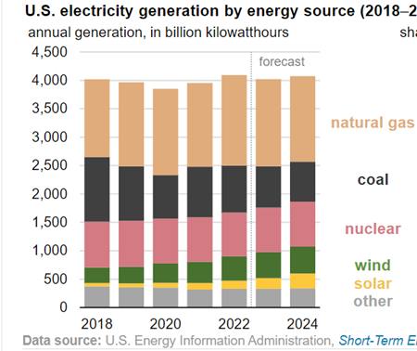
Planned New Generation 2024
Vogtle Unit 3 went into operation in July 2023; Unit 4 should be going in-service soon (in got delayed in Feb 2024 to the second quarter 2024)
Source: EIA
30

Slide 32
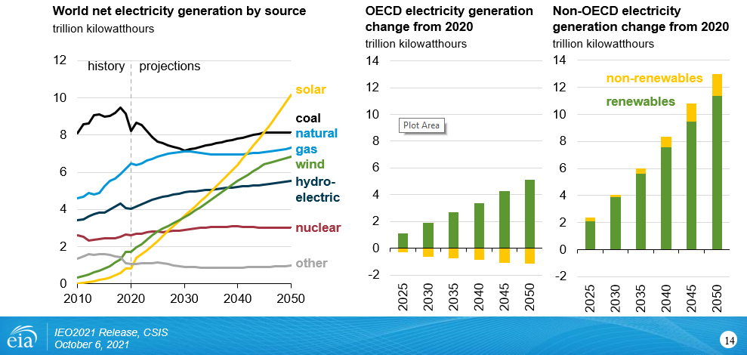
The World: Electricity Consumption by Source
31

Slide 33
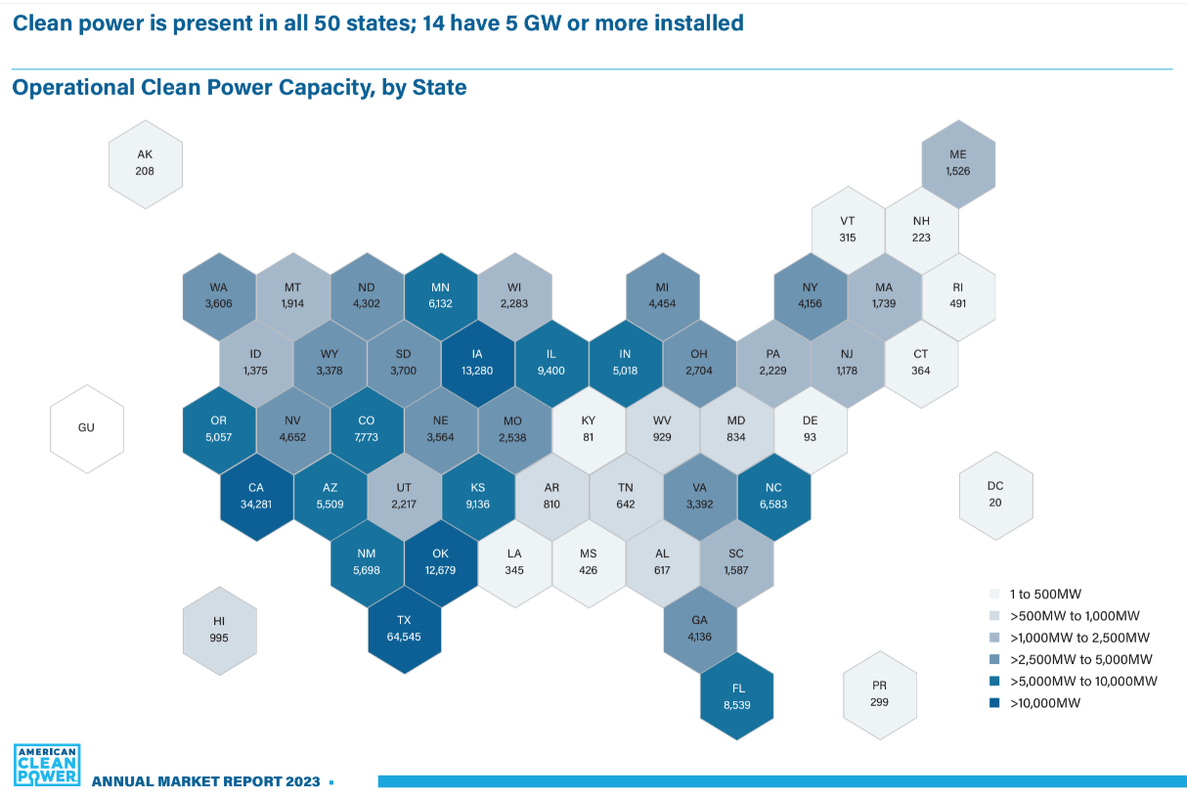
US Wind and Solar Capacity by State
Total US capacity at the end of Nov 2023 was about 148 GW of wind, 91 GW of utility-scale solar, and 47 GW of small scale solar (compared to a total US capacity of about 1200 GW)
Source: Clean Power Quarterly, 4th Quarter 2023
32

Slide 34
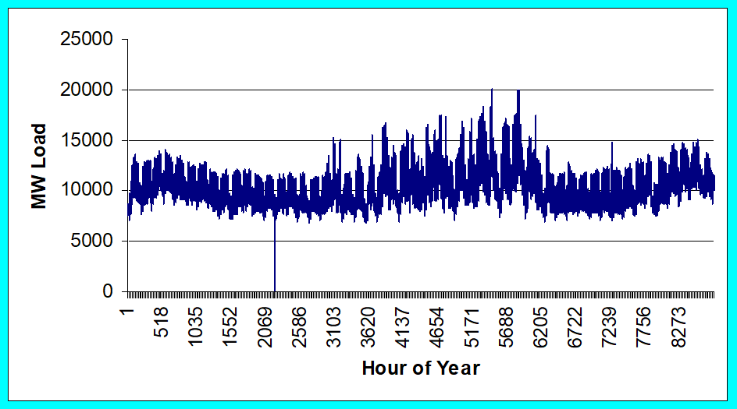
Loads
Can range in size from less than one watt to 10’s of MW.
Loads are usually aggregated.
The aggregate load changes with time, with strong daily, weekly and seasonal cycles.
ComEd Yearly Load
33

Slide 35
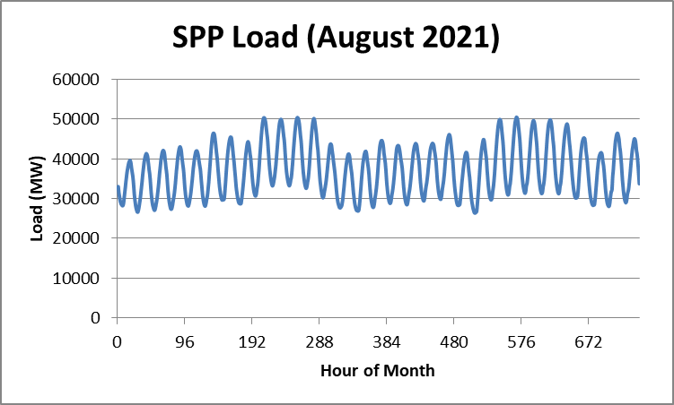
Example: Southwest Power Pool Monthly Load
SPP Load Data Source: marketplace.spp.org
34

Slide 36
Transmission and Distribution
Goal is to move electric power from generation to load with low losses.
Less losses at higher voltages (S=VI* and I²R losses), but more difficult to insulate.
Typical high voltage transmission voltages are 765, 500, 345, 230, 161, 138 and 69 kV.
Lower voltage lines are used for distribution (12.4 or 13.8 kV).
Typical losses are about 3 to 5% in transmission and 10 to 15% in the distribution system.
35

Slide 37
Transmission & Distribution
Transmission
networked connections
power can be supplied from multiple sources
typically higher voltages, above 100 kV
mostly overhead, with some underground in urban areas
Often source of large-scale blackouts
Distribution
radial connections
power moves in one direction only
typically lower voltages, below 100 kV
the source of most black-outs, but these are local
Most new construction is underground, especially in suburban and urban locations
36

Slide 38
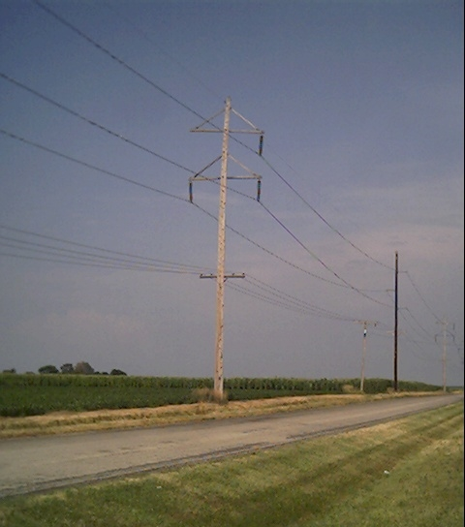
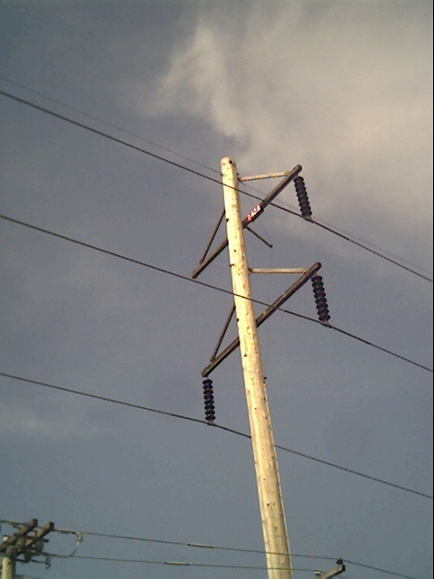
Three Phase Transmission Line
37

Slide 39
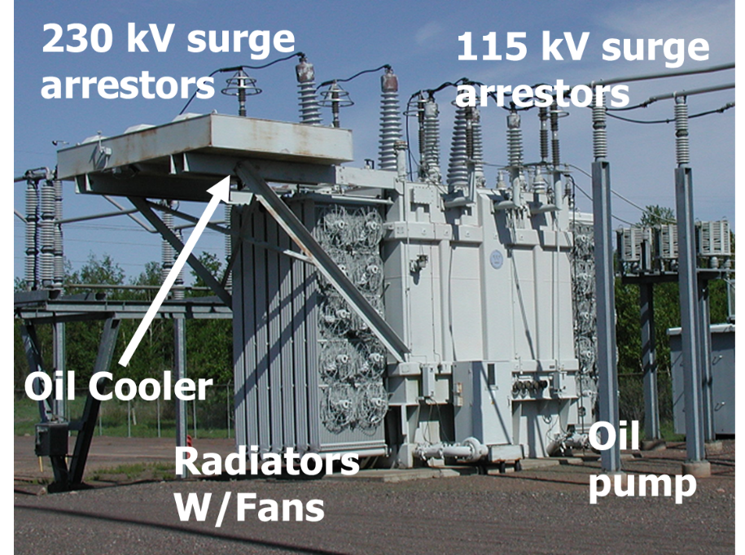
Transformers
Transformers provide an easily means for changing ac voltage levels
Power flow through transformers is bi-directional
Heating is a major concern that can quickly lead to loss of transformer life (and occasionally explosions!)
High voltage transformers (say 230 kV and up) are large, heavy, and difficult to replace
38

Slide 40
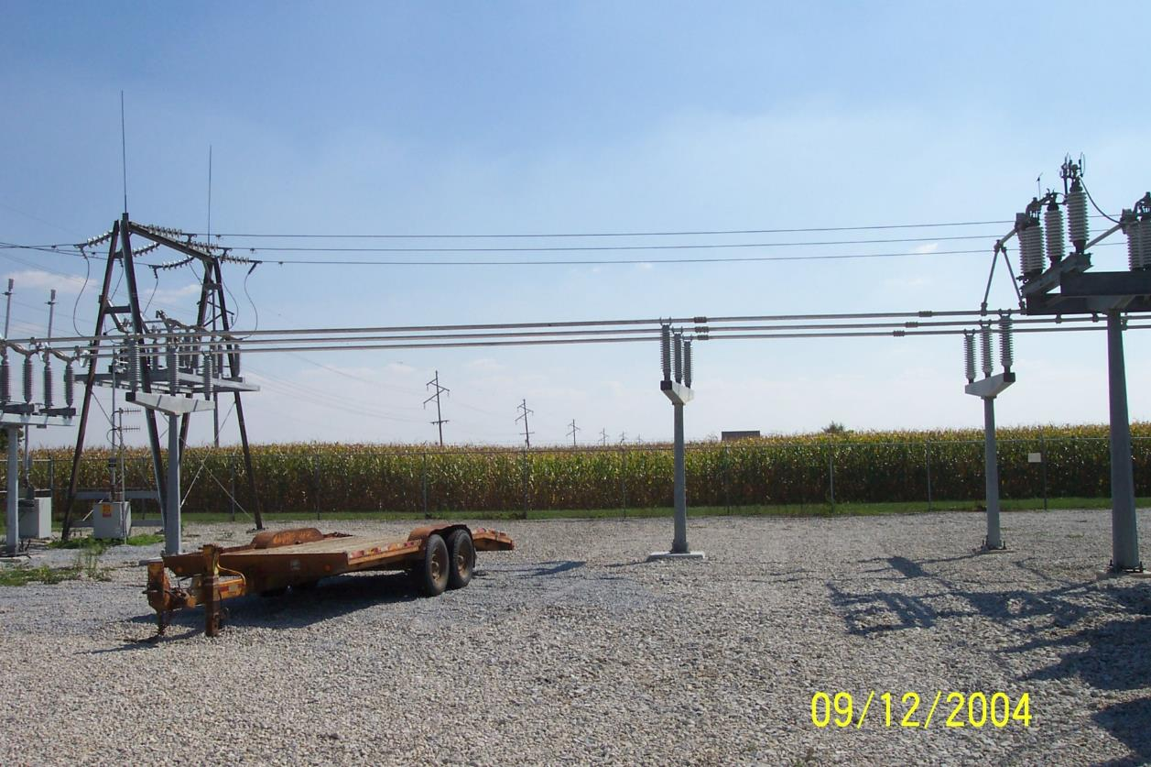
Components Join Together at a Bus
39

Slide 41
Energy Economics
Electric generating technologies involve a tradeoff between fixed costs (costs to build them) and operating costs
Nuclear and solar high fixed costs, but low operating costs (though cost of solar has decreased substantially recently)
Natural gas/oil have low fixed costs but can have higher operating costs (dependent upon fuel prices)
Coal, wind, hydro are in between
Also the units capacity factor is important to determining the ultimate cost of electricity
40

Slide 42
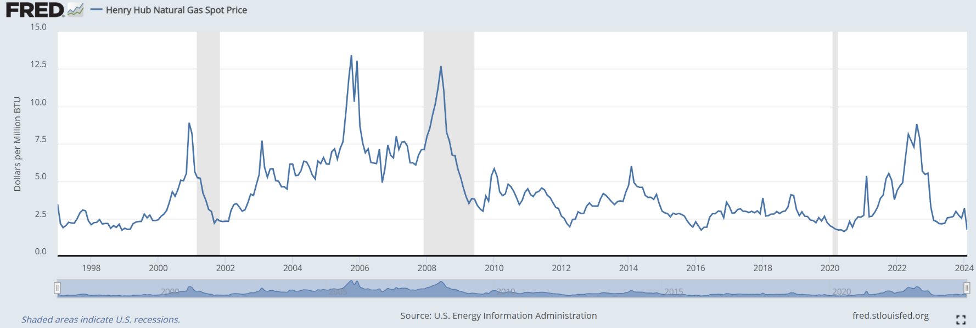
Natural Gas Prices 1997 to March 2024
This variability illustrates a planning challenge
Marginal cost for natural gas fired electricity price in $/MWh is about 7-10 times gas price; Henry Hub is a gas pipeline located in Erath, Louisiana.
Source: fred.stlouisfed.org/series/MHHNGSP
41

Slide 43
Brief History of Electric Power with a Planning Focus
The only thing that is constant is change” Heraclitus (535 – 475 BC)
First real practical uses of electricity began with the telegraph (1860's) and then arc lighting in the 1870’s
Early 1880’s – Edison introduced Pearl Street dc system in Manhattan supplying 59 customers
1884 – Sprague produces practical dc motor
1885 – invention of transformer
Mid 1880’s – Westinghouse/Tesla introduce rival ac system
Late 1880’s – Tesla invents ac induction motor
1893 – Three-phase transmission line at 2.3 kV
42

Slide 44
History, cont’d
1896 – ac lines deliver electricity from hydro generation at Niagara Falls to Buffalo, 20 miles away; also 30kV line in Germany
Early 1900’s – Private utilities supply all customers in area (city); recognized as a natural monopoly; states step in to begin regulation
1918: Charles Fortescue, “Method of Symmetrical Coordinates applied to the Solution of Polyphase Networks,”
By 1920’s – Large interstate holding companies control most electricity systems
1930’s – Electric utilities established as vertical monopolies
43

Slide 45
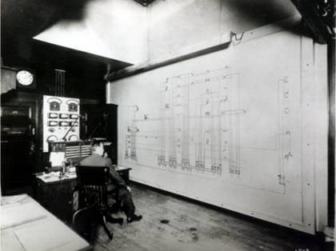
ComEd Control Center: Circa 1920

Slide 46
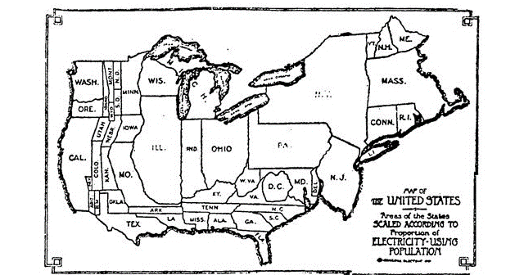
History, cont’d
Map of which states had the most electric generation in 1921
1927: PJM formed with three utilities
1933: Tennessee Valley Authority
The invention of self-starting synchronous machines in 1916 led to motorized clocks, which led to time error correction
45

Slide 47
History, cont’d
Frequency standardized in the 1930’s
Short circuit analysis done using a dc calculating power (since 1920’s); power flows determined using network analyzers
In mid 1950’s there were 50 network analyzer installations in North America
Transmission voltages up to 345 kV by 1949
During 1940’s to 1960’s utilities gradually interconnected their systems so by 1970 transmission lines crisscrossed North America, with voltages up to 765 kV
46

Slide 48
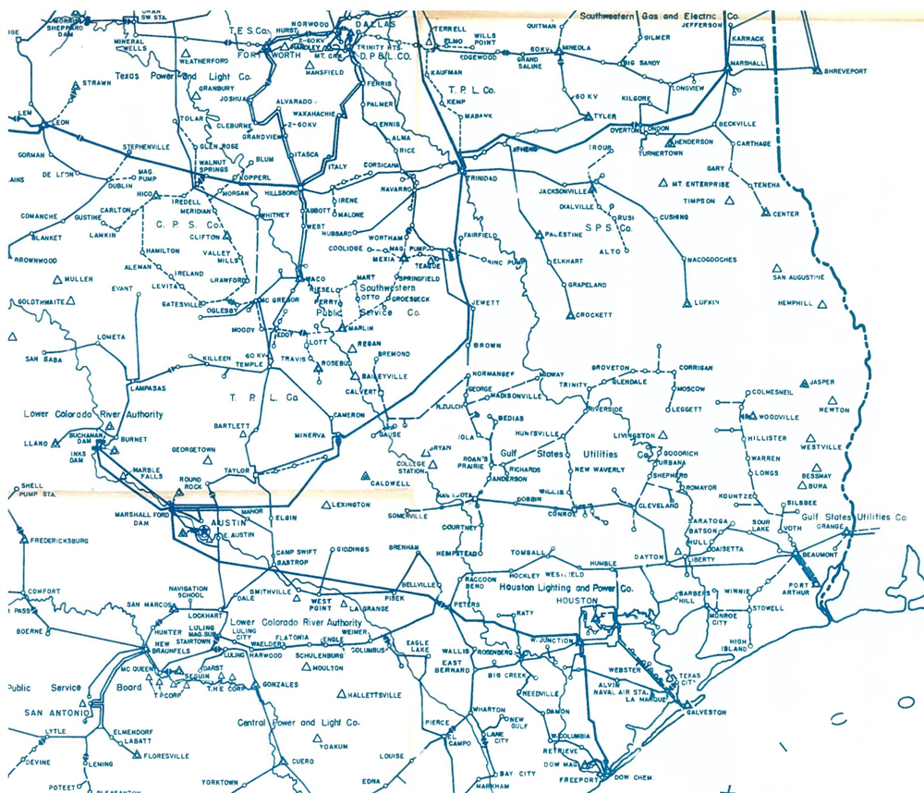
Southeast Texas Grid, 1943
Bryan and College Station evidently had no lines at or above 22 kV!
47

Slide 49
History, cont’d
1956: James Ward and Harry Hale, “Digital Computer Solution of Power Flow Problems”
Power flow and load flow have been used interchangeably since at least the 1950’s ; 1960’s: Sparsity develops, power flow by Newton’s method
Northeast blackout of 1965 affects over 30 million people
1969: First 765 kV transmission in US
1970’s brought inflation, increased fossil-fuel prices, calls for conservation and growing environmental concerns
Increasing rates replaced decreasing ones
As a result, U.S. Congress passed Public Utilities Regulator Policies Act (PURPA) in 1978, which mandated utilities must purchase power from independent generators located in their service territory (modified 2005)
48

Slide 50
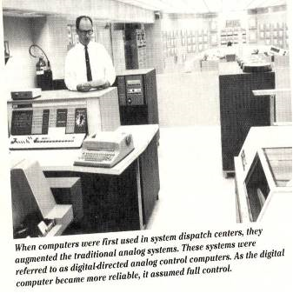
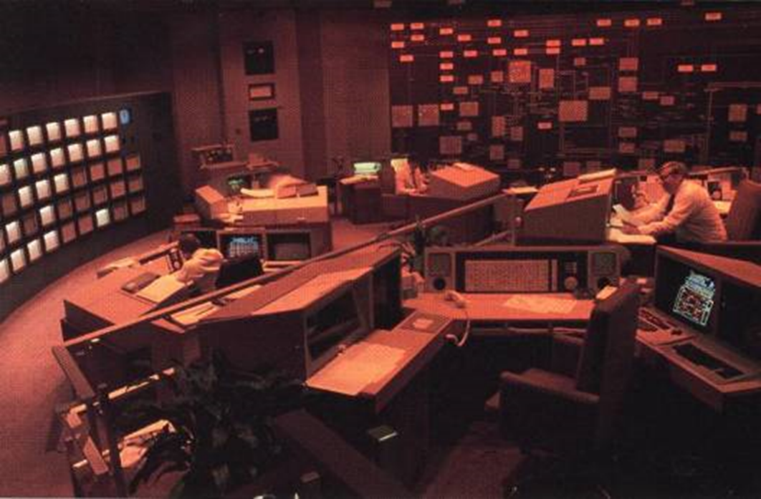
Utility Control Centers: Early 1960’s and 1988
Left Image Source: G.W. Stagg, M. Adibi, M. Laughton, J.E. Van Ness, A.J. Wood, “Thirty Years of Power Industry Computer Applications,” IEEE Computer Applications in Power, April 1994, pp. 43-49
Right Image Source: J.N. Wrubel, R. Hoffman, “The New Energy Management System at PSE&G,” IEEE Computer Applications in Power, July 1988, pp. 12-15
49

Slide 51
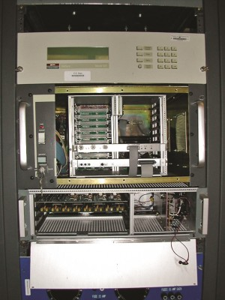
The First Phasor Measurement Units (PMUs), 1980’s
1979: Paper by Thorp, Phadke, Horowitz, and Beehler, “Limits to Impedance Relaying”
1983: Paper by Phadke, Thorp, and Adamiak, “A New Measurement Technique for Tracking Voltage Phasors, Local System Frequency, and Rate of Change of Frequency”
1985: Paper by Thorp, Phadke, and Karimi, ““Real-Time Voltage Phasor Measurements for Static State Estimation”
Source: A.G. Phadke, “PMU Memories,” sites.ieee.org/pes-enews/2015/09/13/pmu-memories/

Slide 52
History, cont’d
Major opening of industry to competition occurred as a result of National Energy Policy Act of 1992
This act mandated that utilities provide “nondiscriminatory” access to the high voltage transmission
Goal was to set up true competition in generation
Result over the last few years has been a dramatic restructuring of electric utility industry (for better or worse!)
Energy Bill 2005 repealed PUHCA; modified PURPA
Electric grid restructuring took place in the 1990’s into the 2000’s
Goal has been to reduce rates through the introduction of competition and consumer choice
51

Slide 53
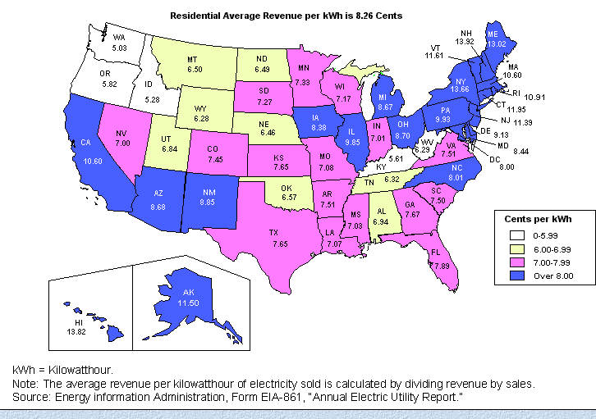
Historical State Variation in Electric Rates
52

Slide 54
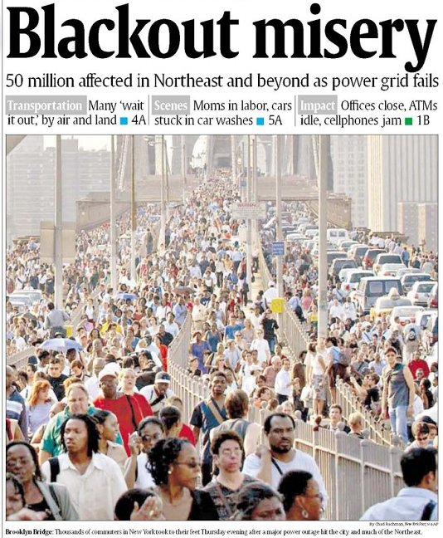
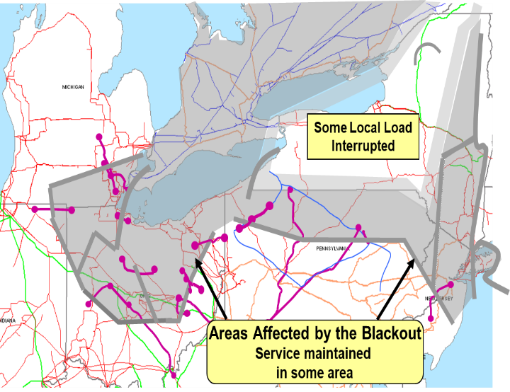
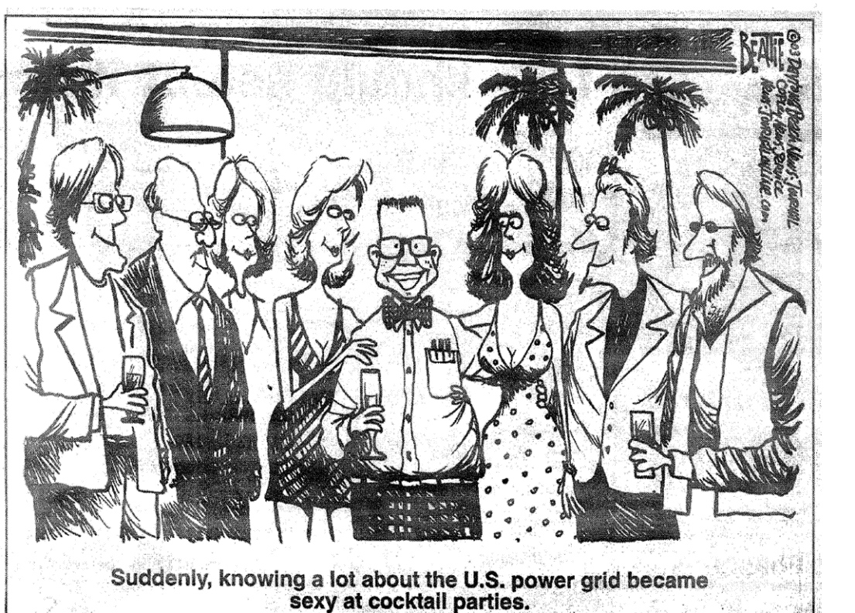
August 14th, 2003 Blackout
Above image from energy.gov, August 14, 2003 Blackout Final Report
I will talk about this event and the 2021 Texas one later in the course
53

Slide 55
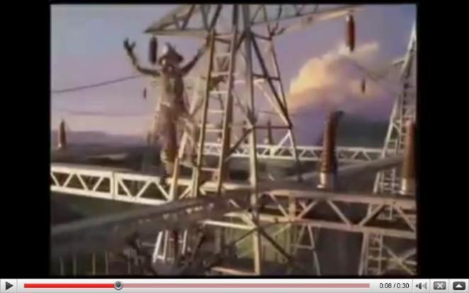
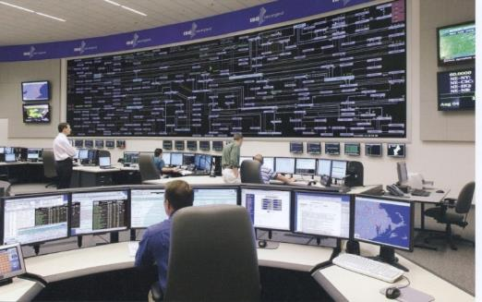
The Smart Grid
The term “Smart Grid” dates officially to the 2007 “Energy Independence and Security Act”, Title 13 (“Smart Grid”)
Use of digital information and control techniques
Dynamic grid optimization with cyber-security
Deployment of distributed resources including
Customer participation and smart appliances
Integration of storage including PHEVs
Development of interoperability standards
54

Slide 56
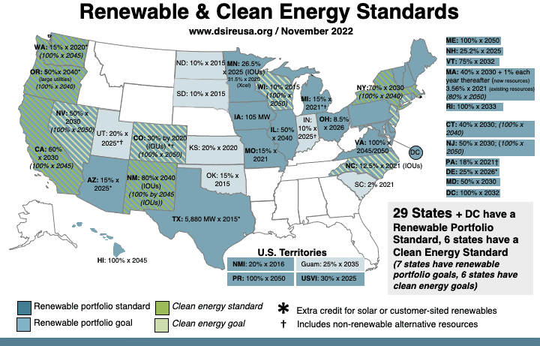
Renewable Portfolio Standards (November 2022)
TX is now 10 GW by 2025 which we’ve met a number of times over
Image source: http://www.dsireusa.org/
See also www.ncsl.org/research/energy/renewable-portfolio-standards.aspx
55

Slide 57

Questions?
56

